Slide 1
Connected Hardware for Software Engineers 101
Pance Cavkovski, Netcetera

Slide 2

whoami
senior software engineer @ Netcetera
jug.mk Leader
codefu.mk admin
hardware & IoT enthusiast
http://pance.mk/ and @hsilomedus

Slide 3
You can do hardware
Yes, yes you can!
It’s cheap
It’s accessible
It’s way easier than before.
…and you can buy stuff online.

Slide 4

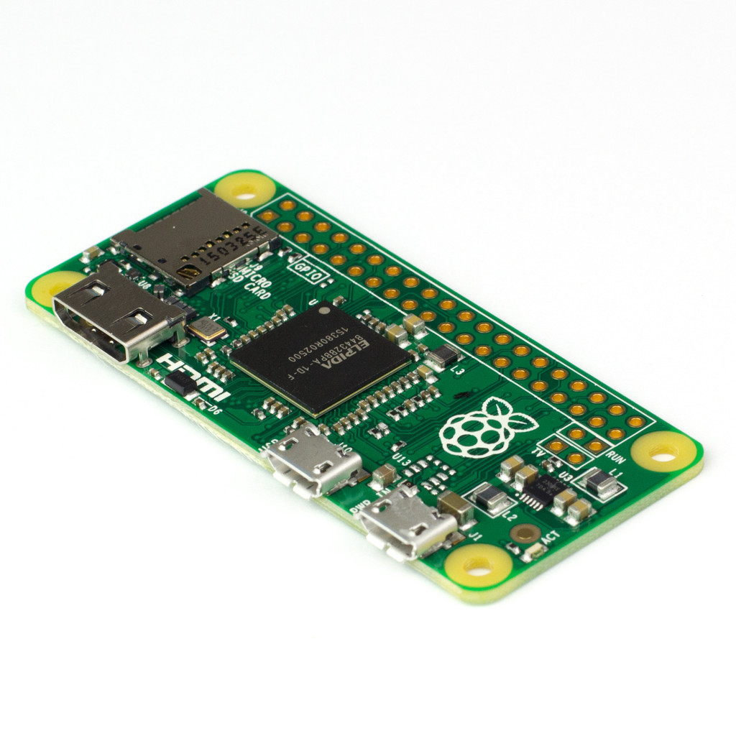
RaspberryPi Zero
1 GHz ARM CPU
512 MB RAM
Hardware video support
HDMI/USB
GPIO headers!
Can run Java and JavaFX!
Bundled JDK8 with Raspbian
$5

Slide 5
pi4j
JNI to wiringpi C library
Can export & control GPIO pins as I/O
Supports SPI, I2C, UART
Managed and unmanaged access
Extension packages

Slide 6
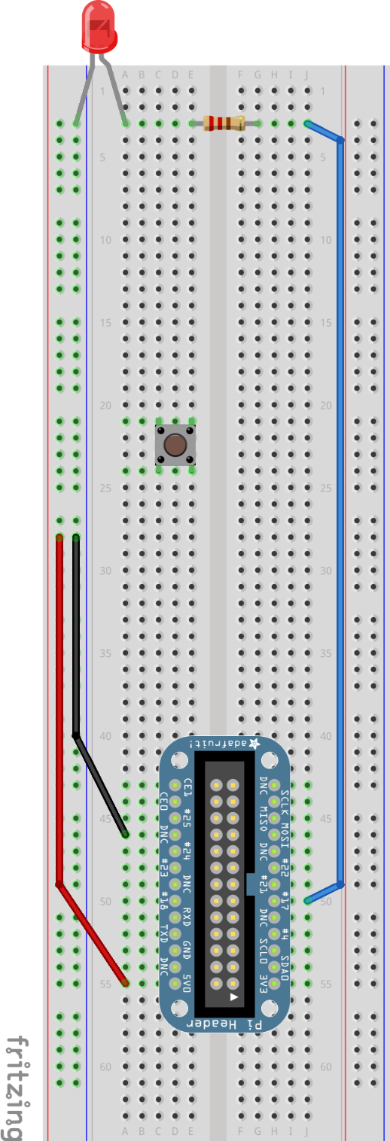
Hello World!
GpioController gpio = GpioFactory.getInstance();
GpioPinDigitalOutput pin =
gpio.provisionDigitalOutputPin(
RaspiPin.GPIO_00, "LED", PinState.HIGH);
Thread.sleep(5000);
pin.low();
gpio.shutdown();

Slide 7
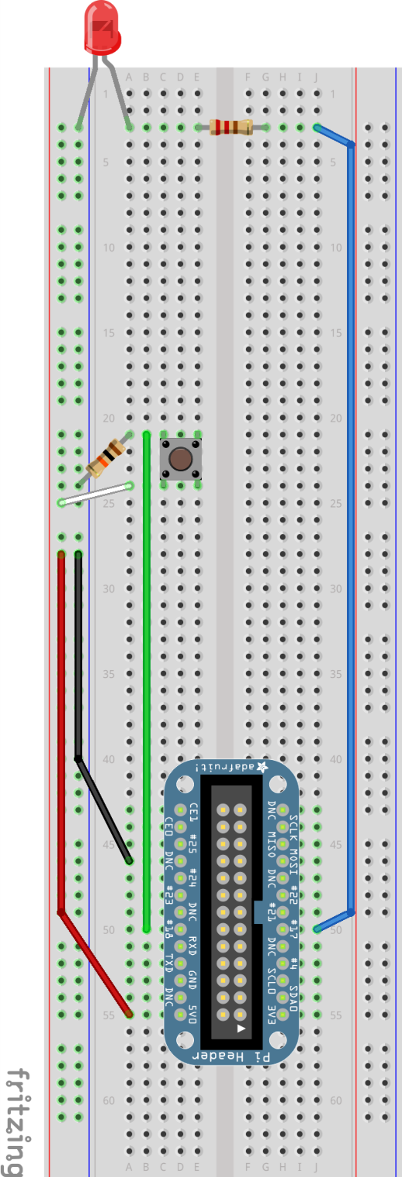
What’s up world?
GpioController gpio = GpioFactory.getInstance();
GpioPinDigitalOutput pinOut =
gpio.provisionDigitalOutputPin(
RaspiPin.GPIO_00, "LED", PinState.HIGH);
GpioPinDigitalInput pinIn =
gpio.provisionDigitalInputPin(
RaspiPin.GPIO_01, PinPullResistance.PULL_DOWN);
pinIn.addListener(event -> {
if (event.getState().equals(PinState.HIGH)) {
pinOut.toggle();}});

Slide 8
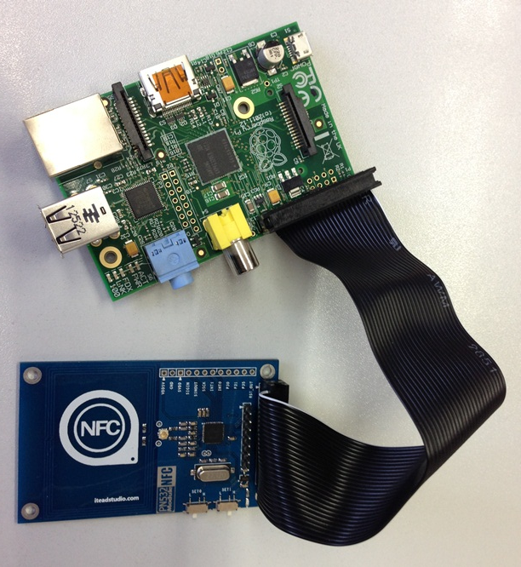
Other stuff you can do
Abstractions for UART, SPI and I2C
Can connect third party modules (e.g.: NFC)
But … can’t do any analog I/O directly…
Bad fast SPI processing…

Slide 9
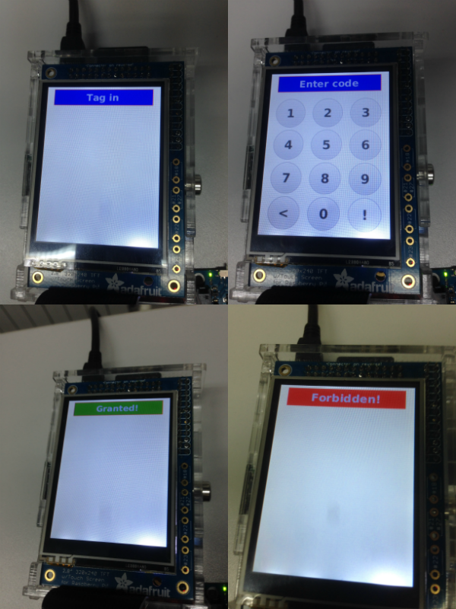
Also: Open JFX
Step 1: Acquire PiTFT (or a replica if you will…)
Step 2: Download and extract OpenJFX binaries *
Step 3: Build your project
Step 4: Execute with: -Djava.ext.dirs=dir/to/jfx/ext -Dglass.platform=Monocle -Dmonocle.screen.fb=/dev/fb1 -Dprism.order=sw
Step 0: Be careful: 320x240 with precautions
*) Reliable source: http://108.61.191.178/

Slide 10
What about analog?
And can I make it simpler? Cheaper? Out of the box connected?

Slide 11
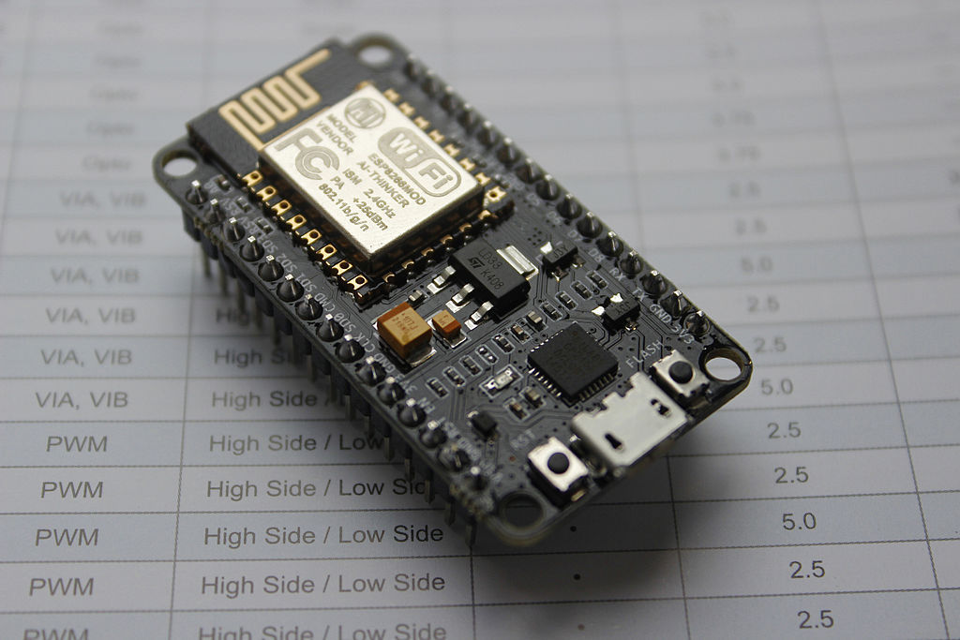
NodeMCU devkit (ESP8266)
Development / Prototyping board
Arduino like
Based on ESP-12(E)
Fully programmable

Slide 12
NodeMCU devkit cont.(ESP8266)
GPIO, 1 ADC, UART, SPI
Built-in Wi-Fi
Low-power
$5

Slide 13
Coding for ESP8266
Available Arduino port!
Download, install boards manager, driver.
https://github.com/esp8266/Arduino

Slide 14
Coding for ESP8266
Can be set to work as a Soft AP or Wi-Fi Client
Available libraries + examples (Arduino):
- (Advanced) WebServer
- WebSockets
- NeoPixelBus
- DHT11
- etc…

Slide 15

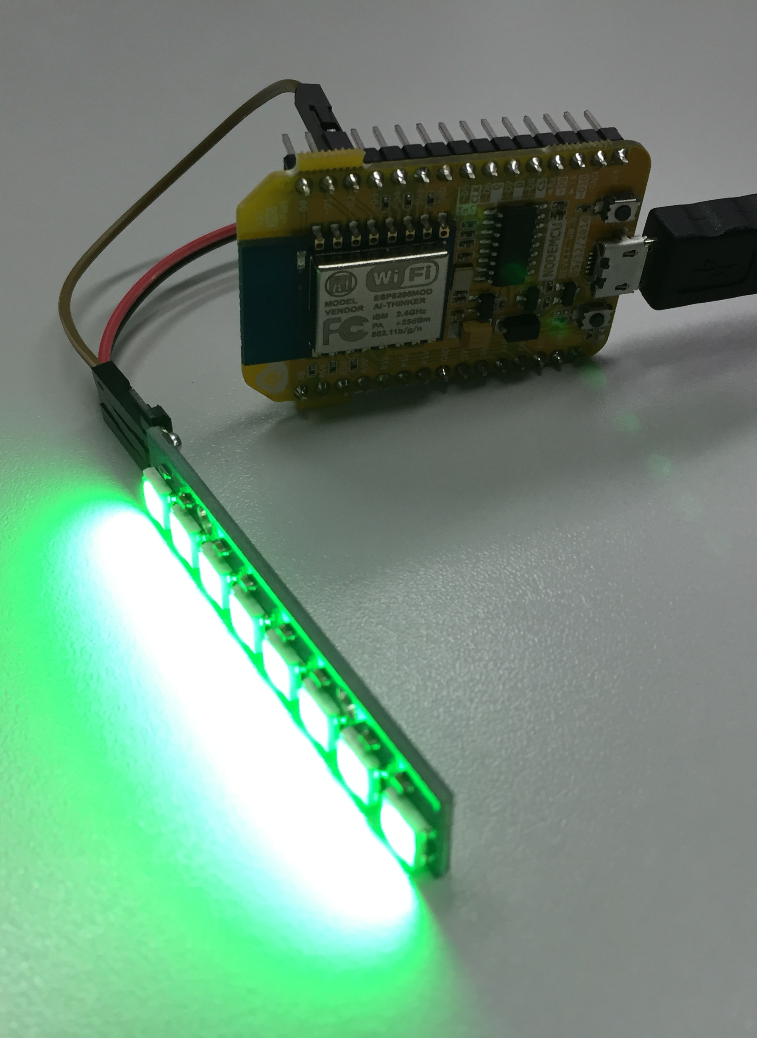
E.g.: Wi-fi Light
NodeMCU 0.9 + 8 x WS2812 (NeoPixels)
Connect to a network
Start up Advanced Web Server
Show UI and Handle requests
Use NeoPixelBus
BlogPost + code @ pance.mk

Slide 16
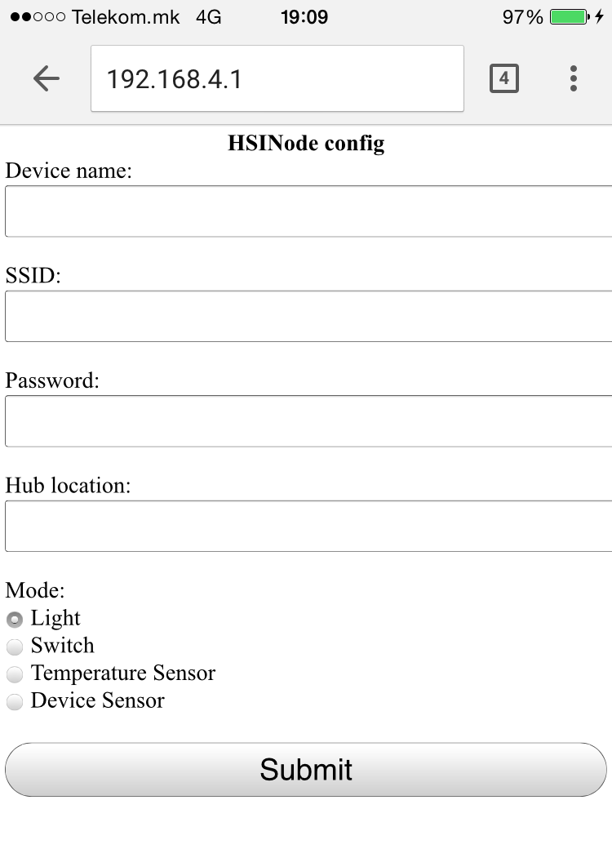
Make it configurable
Start a Soft AP with web-server for configuration
User enters data via a smart phone
Store data in EEPROM
Device reboots and initializes
On error or change: hardware reset button.

Slide 17
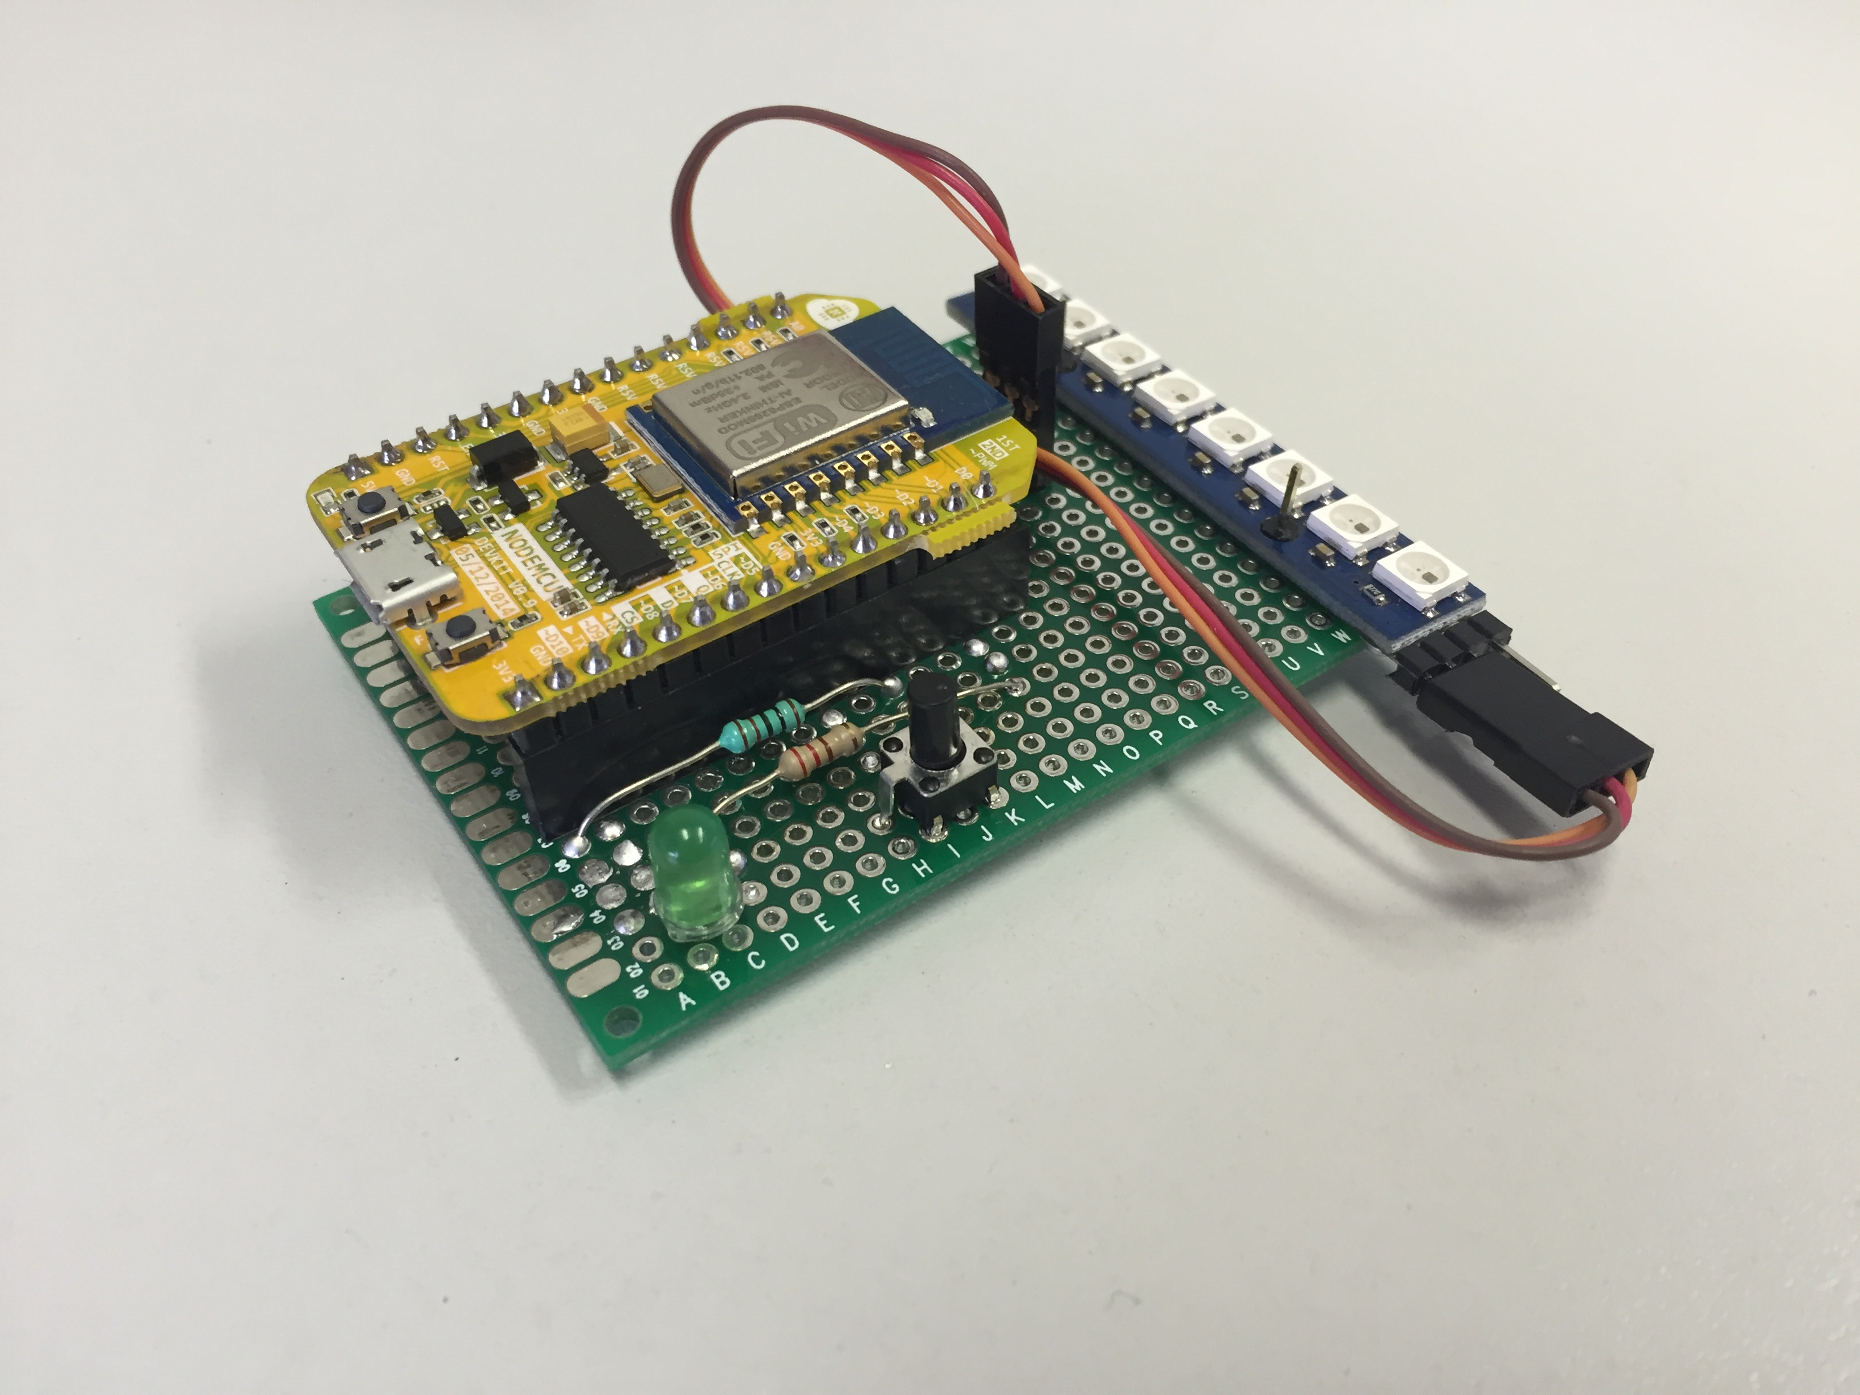
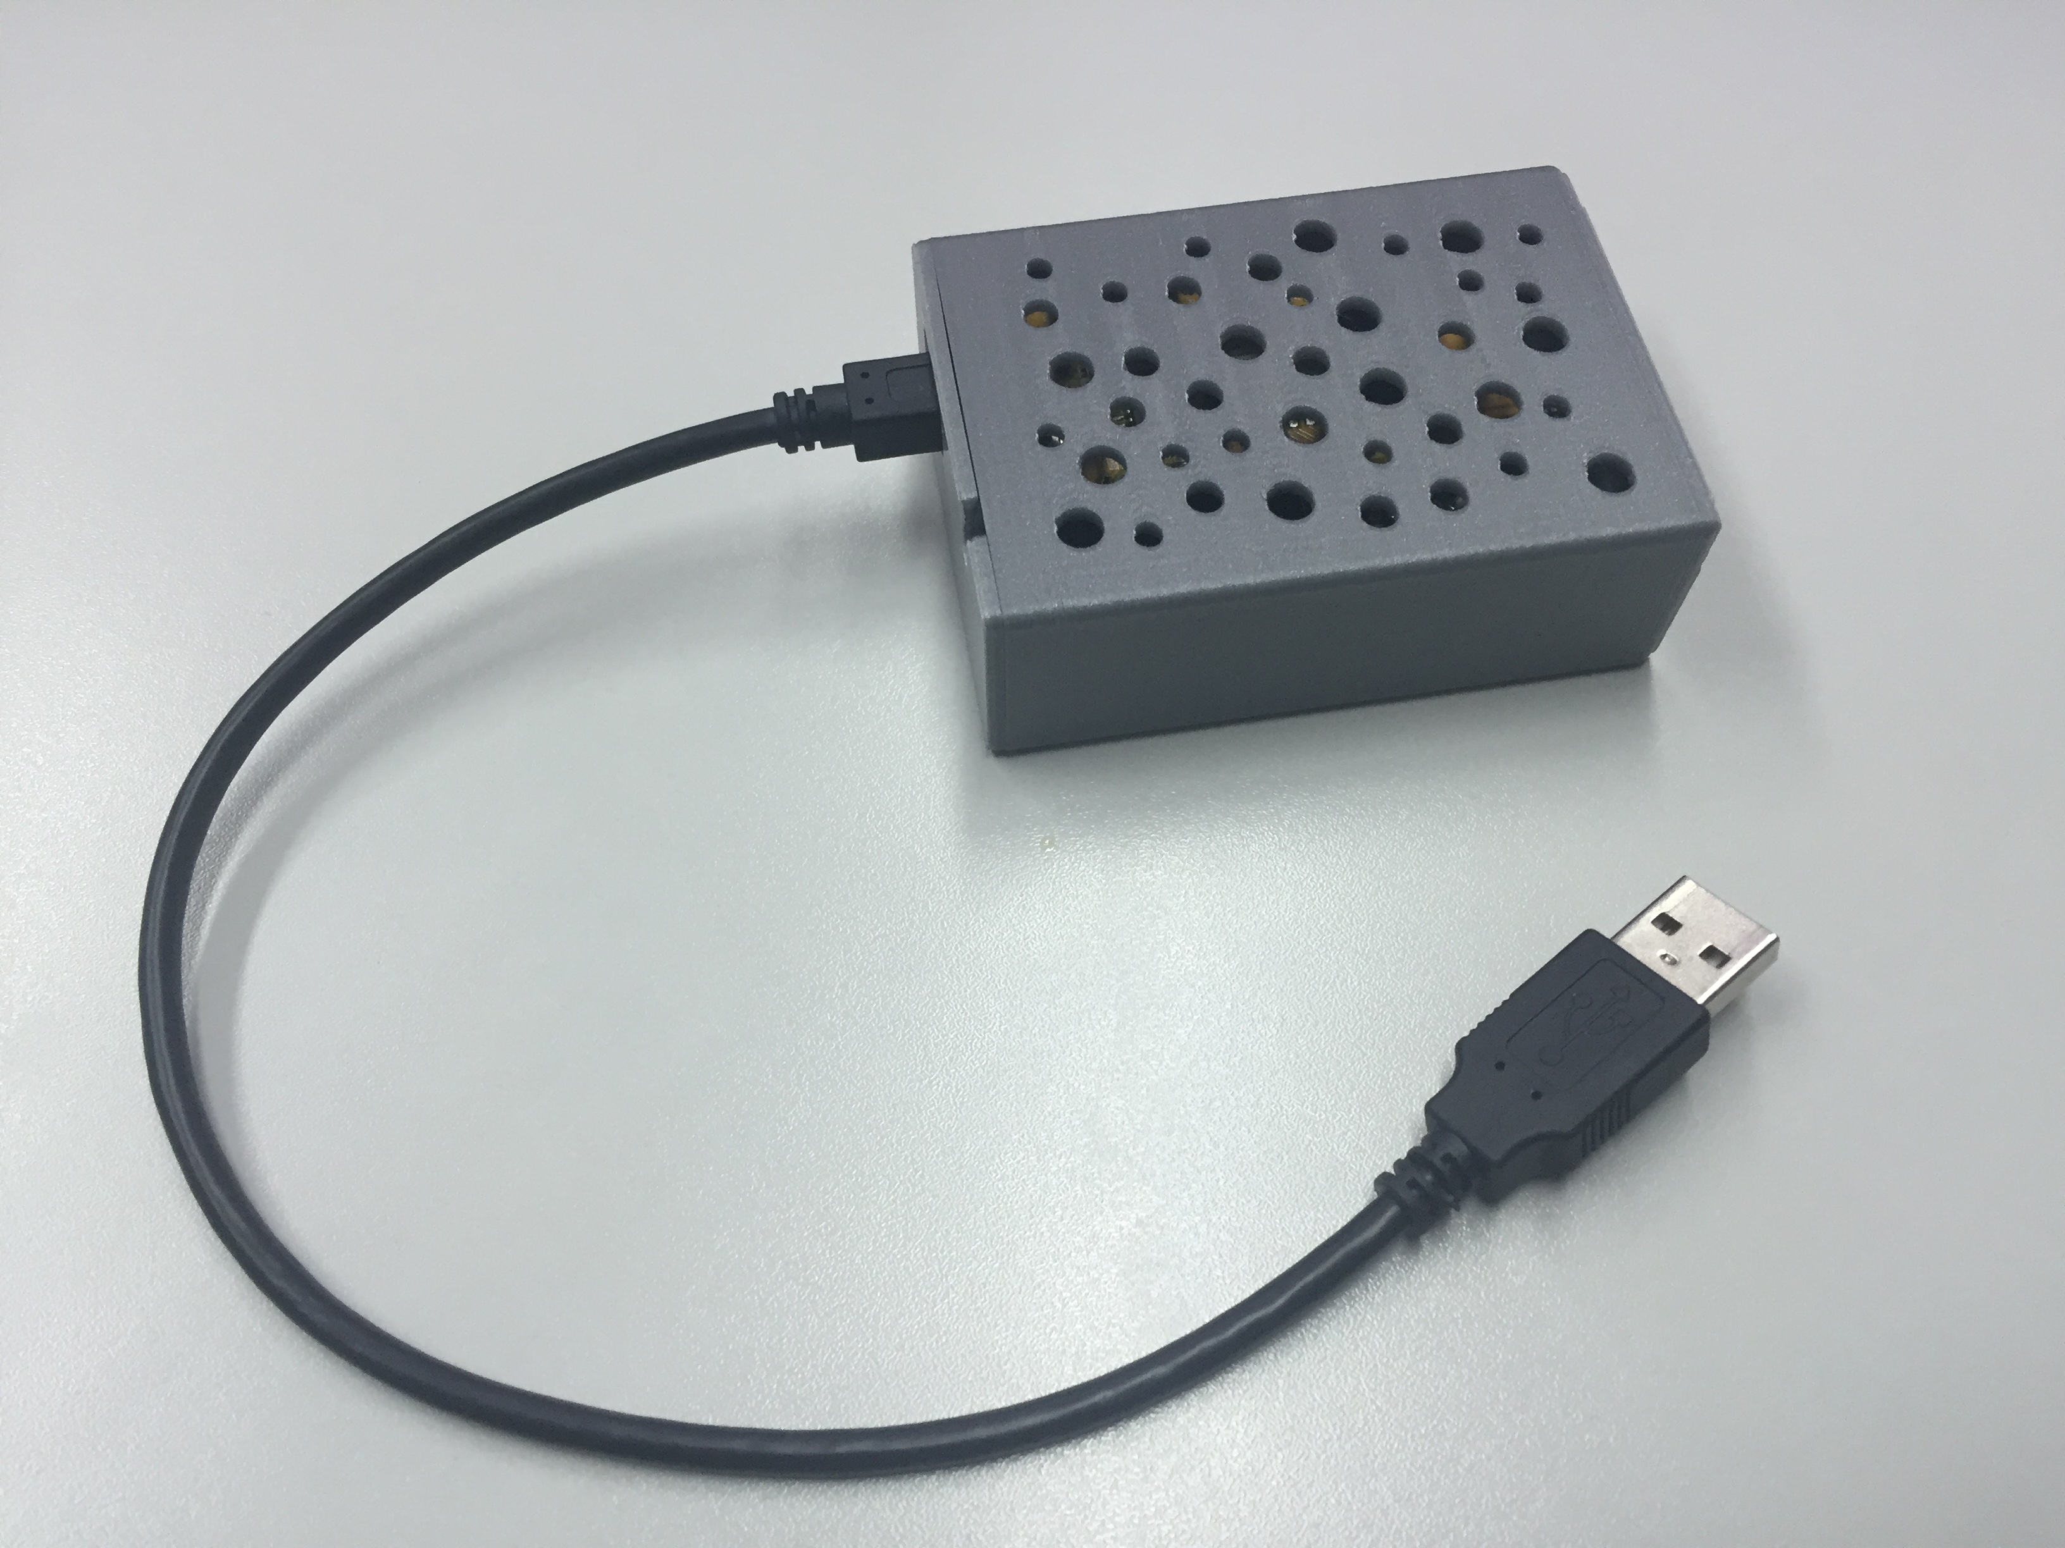
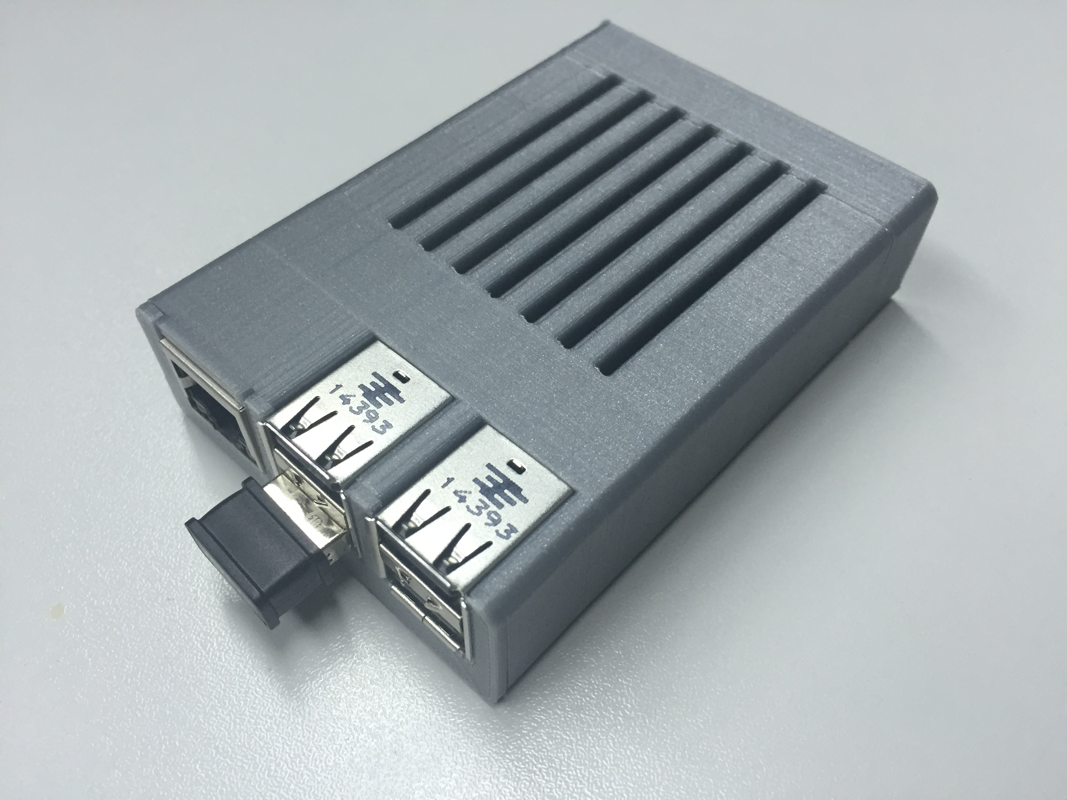
Make actual hardware nodes
Prototype board
3D case and model
Custom PCB + enclosure
Product?

Slide 18
How to get started?
Get a RaspberryPi2 / RaspberryPi zero / ESP8266 startup kits
Visit pij4.com, download it and go through the examples
Download the ESP8266 Arduino port and go through the examples
Learn the syntax and experiment.

Slide 19
Learn a thing or two for hardware
There are a lot of tutorials out there, start with them (e.g. adafruit)
Get to know the basics of digital electronics and interfaces
Learn what’s behind analog electronics and know the building blocks
Use a breadboard and experiment

Slide 20
Actually make something
Teach yourself how to design and make a PCB
Learn and practice soldering
Invest into 3D modeling and maybe printing
Checkout Fritzing and Thingiverse.

